Slide 1
Adversarial Search: Games
CS161
Guy Van den Broeck

Slide 2
Adversarial Search Problems
Long history in CS
Babbage, Zermelo, Von Neumann, Shannon, Turing, McCarthy, etc., all studied games
Especially Chess
Complicated enough to be challenging
Abstract enough to be well-defined (rules)
Different types of games
Perfect/imperfect information
Deterministic/chance
(non-)zero-sum

Slide 3
Adversarial Search Problems
Like a search problem but
Opponent actions (uncertainty)
Often large branching factor (35 in chess)
Often large depth (around 100 moves in chess)
Time limits (sometimes)
Utility function (win/loss/draw)
Solution is now a strategy (depends on opponent move)
Or just decide next move and then see what happens

Slide 4
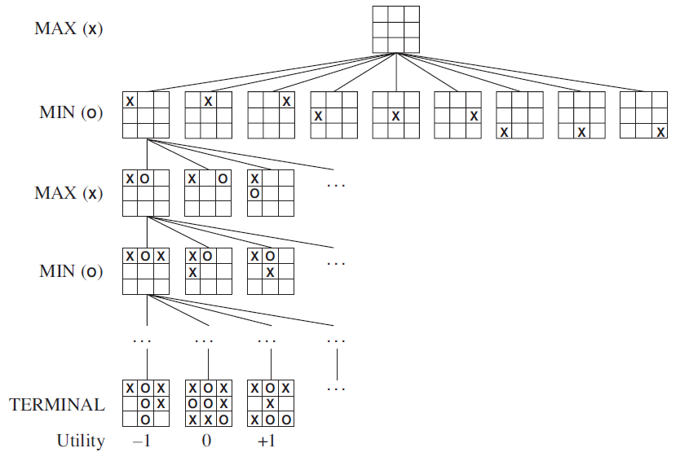
Half-Move Ply
Move
Half-Move Ply
255,000 leaf nodes
zero-sum game

Slide 5

Minimax Search

Slide 6
-5 -2 1000

Slide 7




Slide 8
Three Players (and a non-zero-sum game)

Slide 9
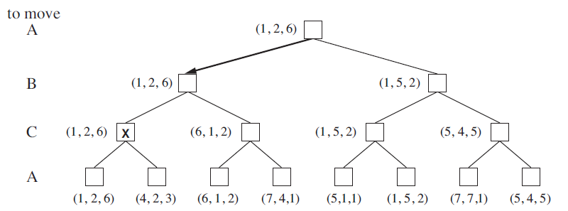
Three Players (and a non-zero-sum game)

Slide 10
Can we save time?

Slide 11
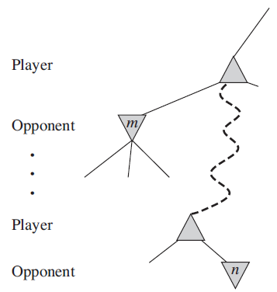
Alpha-Beta Pruning

Slide 12
What if game tree still too large?

Slide 13
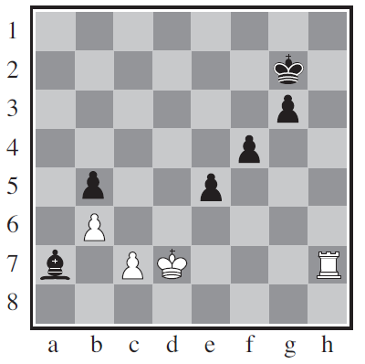
Horizon Effect: Black to Move
Notes:
Black bishop is doomed; black can forestall by checking the white king with pawns

Slide 14
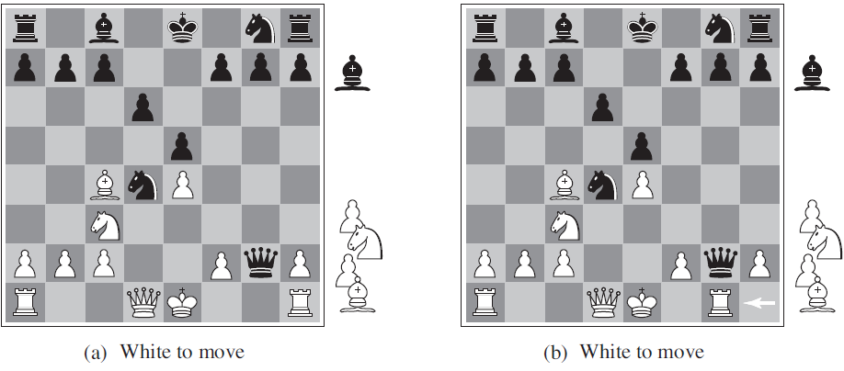
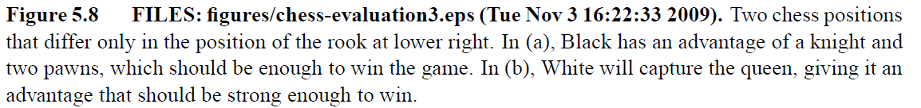
Evaluation: Tricky

Slide 15
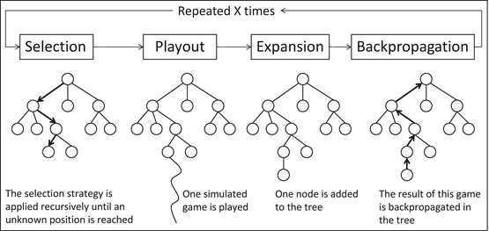
State of the Art: Monte-Carlo Tree Search

Slide 16
How to select where to go in the tree?

Slide 17
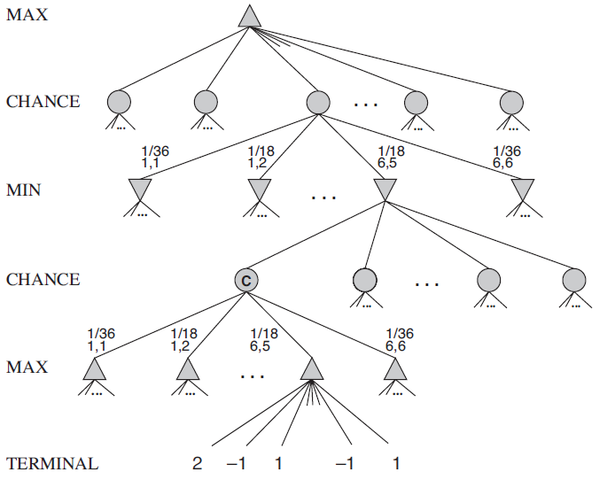
Chance: Expecti-Minimax

Slide 18
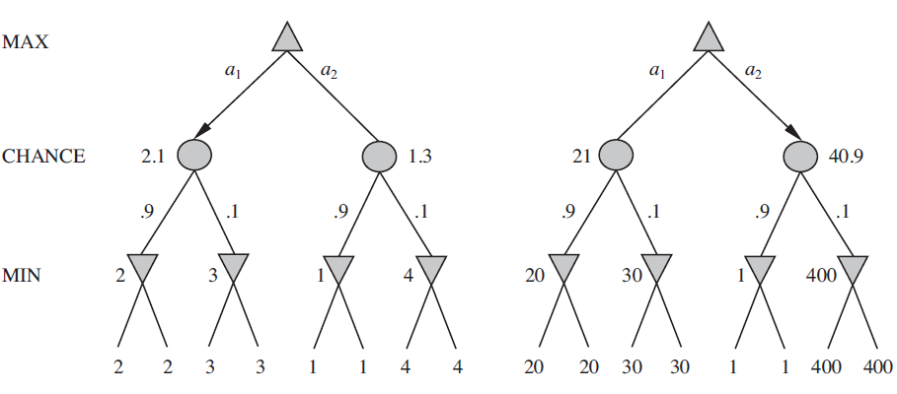
Changing Rewards

